Slide 1
Machine Learning in Business Decision Making
How to Think About Machine Learning in Business Decision Making
Lesson 01, Section 01

Slide 2




What is Machine Learning?
?
Artificial Intelligence
Input Data
Output / Predictions
Machine Learning Model
Raw data that the ML model learns from
Algorithm that finds patterns and learns from the data
Predictions or decisions generated by the model
Notes:
What is Machine Learning?
Machine learning is a part of artificial intelligence that builds systems that learn from data step by step and make predictions.
Machine Learning start by collecting input data such as:
Numbers
Text
Images
Logs
Machine Learning Model learns patterns from the input data and builds internal rules.
Example of ML models include Linear Regression, Decision Trees, Neural Networks, Clustering Models
Output of the Machine Learning model can be
Predictions
Classifications
Recommendations
Detected anomalies

Slide 3
3 Steps of Process Machine Learning
Automation
Customization
Acceleration
Artificial Intelligence
Notes:
Machine learning can be understood as a process with three main steps:
- Automation, Customization, and Acceleration.

Slide 4


Machine Learning
Automation
Customization
Acceleration
minimizes human intervention in the
model-building process
identifies patterns and makes predictions
learns iteratively from the data
Notes:
What is Automation?
Machine learning is mostly an automated process.
This means the system can build a model with very little human work.
You just click “Run,” and the system starts learning from the data on its own, using algorithms instead of manual programming.
As the system goes through the data again and again, it learns step-by-step (iteratively).
Each time, it becomes better at finding patterns and making predictions.
A neural network is one example of a machine learning model.
In a neural network, the model begins with weights (values) that are close to zero.
Every time the model trains on the data, these weights are adjusted.
This helps the neural network improve and make more accurate predictions.

Slide 5
Machine Learning
Automation
Customization
Acceleration
decision trees and other tree-based models
neural
networks
support vector machines
. . .
Notes:
Machine learning can be customized, which means you can choose different types of models depending on what you need.
Different problems require different tools, so machine learning lets you pick the model that fits the situation best.
What “customized” means
- You are not limited to one type of algorithm.
- You can choose from many models based on your data and your goal.
Common types of machine learning models:
A. Decision trees / tree-based models
- Work like flowcharts that split data step by step.
B. Neural networks
- Work like little “brains” that learn patterns from many examples.
C. Support vector machines (SVM)
- Find the best line or boundary to separate different groups of data.
D. Others…
- Many more models exist, and you can select whichever works best.
Main idea
- Machine learning is flexible.
- You can customize the learning process by choosing the type of model that best solves your problem.

Slide 6

Machine Learning
Automation
Customization
Acceleration
Look for fast response time for sophisticated analytics applied to data of any size or complexity
Notes:
What is Acceleration?
- Machine learning helps things run faster, especially when working with large or complex data.
- It can process big amounts of information quickly and still give accurate results.
- This means you can get answers or predictions much sooner, even when the data is very big or detailed.
- In short: Machine learning accelerates (speeds up) the whole analytics process so results come quickly.

Slide 7
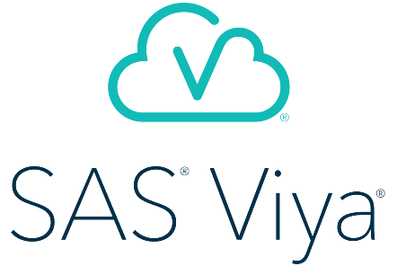
cloud-enabled,
in-memory
analytics run-time environment
SAS® Viya®
SAS
SAS®9
Notes:
- Machine learning is similar to other fields that work with data.
- SAS Viya is a platform that gives you the tools you need to do machine learning.
- SAS Viya is a cloud-based system.
- This means it runs on the internet instead of your computer.
- It also works in memory, which means it can process data very fast.
- Because of this design, SAS Viya can handle any size of data, no matter how big, how fast it changes, or what type it is.
- In short:
SAS Viya runs in the cloud
It processes data quickly using in-memory technology
It can scale up easily to handle very large or complex data
It provides tools that support machine learning

Slide 8


templates
autotuning
build an initial model quickly
specifies model settings automatically
Automation
Customization
Acceleration
Autotuning is disabled in SAS Viya for Learners, and selecting it results in an error.
Notes:
- Templates help you create a basic model very quickly.
- They give you starting settings so you don’t need to set everything yourself.
- Autotuning is a feature that automatically chooses the best model settings for you.
- It tests different options and finds the ones that work best, without you doing it manually.
- After autotuning finishes, you can still add your own knowledge to improve the results.
Important note:
- In SAS Viya for Learners, autotuning is turned off, so if you try to use it, you will get an error.

Slide 9
machine learning algorithms
open
source tools
Automation
Customization
Acceleration
Notes:
You can customize your machine learning work in SAS Viya.
This means you can mix and match tools:
On one side, SAS Viya gives you powerful machine learning algorithms.
On the other side, you can also use open-source tools (like Python, R, or other libraries).
- By combining both, you can build models that fit your exact needs.
- You get the strengths of SAS Viya plus the flexibility of open-source tools.

Slide 10
Analytics Life Cycle
Analysis Goal
Business Challenge
Notes:
Every analytics project begins with a business challenge — a problem the company wants to solve.
After understanding the challenge, the organization defines a clear and specific analysis goal.
This goal must be measurable, so the team knows exactly what they are trying to achieve.

Slide 11
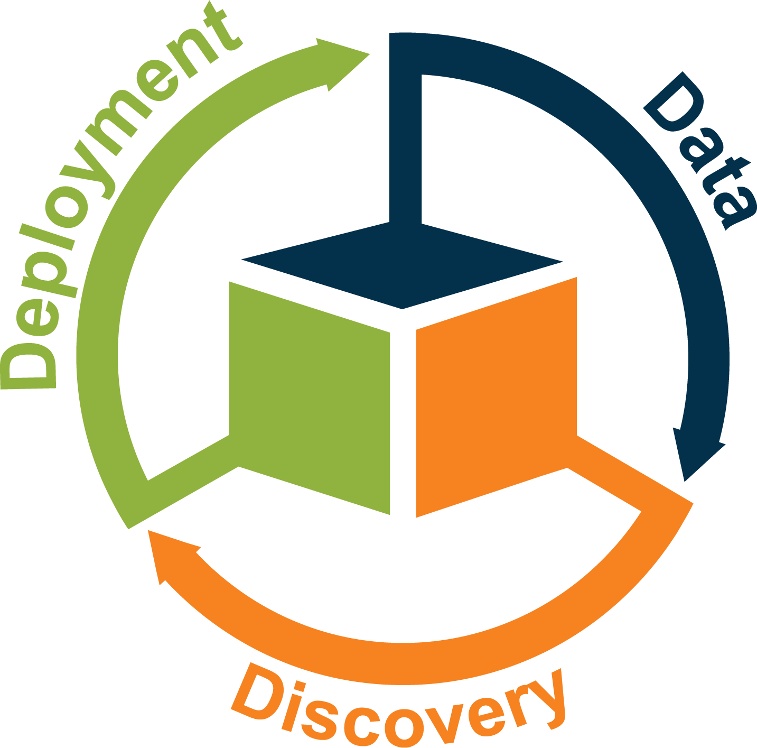
Value
The analytics life cycle represents a series of activities to extract value from raw data.
Notes:
- The analytics life cycle is a process that helps organizations turn raw data into something useful.
- It has one main purpose: to create value from data.
- This life cycle has three main phases:
Data – You collect and prepare the data.
Discovery – You explore the data, analyze it, and build models to find insights.
Deployment – You put the results or models into real use so the organization can benefit.
- By moving through these three phases, the organization can take raw data and turn it into something valuable, such as better decisions or improved processes.

Slide 12

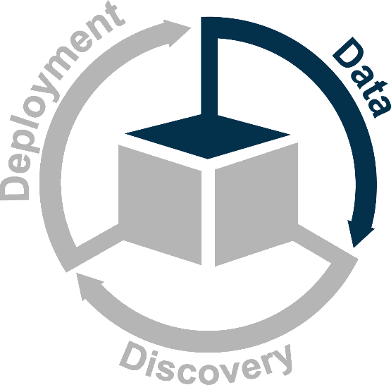


explore and prepare your data for analysis
Notes:
In this step, you work with your data.
This means you look at the data, clean it, fix errors, and get it ready so that you can use it for analysis later.
Good data is very important because it is the foundation of everything you will do in the analytics process.

Slide 13
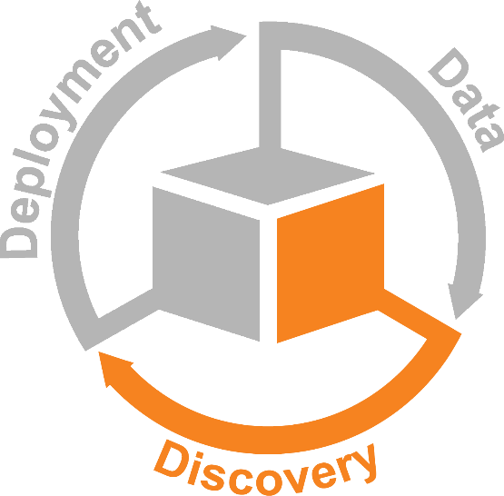




detecting something that you did not know before
build and refine multiple models
select the best model
Notes:
- Discovery means finding something new in your data — something you did not know before.
- During this phase:
You build many different models to understand your data.
You improve and adjust these models.
Then you compare them.
Finally, you choose the best model for your analysis.
- In short: Discovery is about testing many models so you can find the one that works the best.

Slide 14
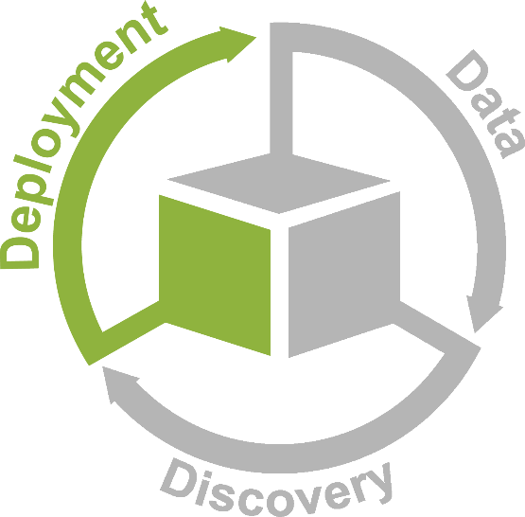
Scoring
Notes:
Deployment is the stage where you start using your machine learning model in real life.
This means:
You take the model you built earlier.
You apply it to new data to get results.
This process of using the model to make predictions on new data is called scoring.
- In short: Deployment = putting your model to work and scoring new data.

Slide 15

essential deployment tasks
essential data tasks
essential discovery tasks
Notes:
The analytics life cycle shows that machine learning creates value at every stage.
Each stage has important tasks you must do:
Data tasks: Collect, clean, and prepare your data.
Discovery tasks: Explore the data, build models, and choose the best one.
Deployment tasks: Use the model in real situations to make predictions.
- As you learn to use SAS Viya in this course, you will practice the key tasks for each stage.
- The life cycle is also flexible — in real projects, you might follow the steps in a different order depending on your needs.

Slide 16




@
Customer Churn
correct prediction
incorrect prediction
Notes:
A phone or internet company is losing customers.
When a customer stops using the company’s service, this is called customer churn 流失.
Churn is a problem because it is more expensive to find new customers than to keep the ones you already have.
客户流失是个问题，因为获取新客户的成本要高于留住现有客户的成本。
Machine learning can help the company predict which customers are likely to leave.
If the model’s prediction is correct, the company can take action to keep the customer.
If the prediction is wrong, the company may spend effort on the wrong person.

Slide 17

@
Customer Churn
Analysis Goal
Identify the customers who are likely to churn.
Notes:
Many companies use analytics to find out which customers might leave (churn) and to understand how to keep them.
Telecommunication companies often use predictive models to lower the churn rate, especially for customers who pay after using the service (post-paid customers).
In this case study, the analysis goal is: Identify the customers who are likely to churn.
The results from this analysis help the company design better programs to keep customers, such as loyalty rewards or special offers.

Slide 18
@
Customer Churn
Did the customer churn?
demographic information
commsdata
Inputs |  |  |  | Target
■ | ■ | ■ | ■ | ■
■ | ■ | ■ | ■ | ■
■ | ■ | ■ | ■ | ■
■ | ■ | ■ | ■ | ■
■ | ■ | ■ | ■ | ■
Inputs |  |  |  | Target
■ | ■ | ■ | ■ | ■
■ | ■ | ■ | ■ | ■
■ | ■ | ■ | ■ | ■
■ | ■ | ■ | ■ | ■
■ | ■ | ■ | ■ | ■
Inputs |  |  |  | Target
■ | ■ | ■ | ■ | ■
■ | ■ | ■ | ■ | ■
■ | ■ | ■ | ■ | ■
■ | ■ | ■ | ■ | ■
■ | ■ | ■ | ■ | ■
product usage and type
billing data
customer service interactions
Notes:
- The company has a SAS table called commsdata. This table contains information about how customers behave.
- In this table:
The input variables (the information used to make predictions) include:
Demographic information (such as age, location, gender, etc.)
Product usage and type (how the customer uses the service)
Billing data (payment history and billing amounts)
Customer service interactions (how often the customer contacted support and why)
- The target variable is a yes/no value that shows whether a customer has churned (stopped using the service).
- This target is what you want the model to predict.

Slide 19
@
Customer Churn
commsdata
Inputs |  |  |  | Target
■ | ■ | ■ | ■ | ■
■ | ■ | ■ | ■ | ■
■ | ■ | ■ | ■ | ■
■ | ■ | ■ | ■ | ■
■ | ■ | ■ | ■ | ■
> 56,000 rows
128 columns
Notes:
The commsdata table is a large data set.
It has 128 columns (128 different pieces of information about each customer).
It also has more than 56,000 rows (over 56,000 customers).
Don’t worry if the words or ideas seem new right now—you will learn everything step by step in the course.
Your task is to use this data set to build supervised machine learning models.
These models will try to predict which customers will churn (stop using the company’s service).
Your instructors will use the same data to teach the lessons.
You will practice doing the same steps they show in the videos.
This will help you build confidence, and you will get extra practice doing machine learning on your own.

Slide 20
Any Business Problem
Customer Churn
Notes:
Even though this course uses customer churn as the example problem, the things you learn can be used for any business problem.
Machine learning and the analytics life cycle (Data → Discovery → Deployment) can be applied to many different tasks, such as predicting sales, detecting fraud, improving marketing, or analyzing operations.
So, the skills you learn in SAS Viya are not only for churn problems—you can use them to solve many other real-world business challenges in many different industries.

Slide 21
Customer Churn
Customer churn is a problem for many businesses. Churn (also known as attrition) is the turnover of customers who use a product or service.
Applications of Prediction-Based Decision Making
Fraud - Fraud is intentionally committing a deceitful act in order to profit or gain an advantage. Fraud detection methods attempt to detect and impede illegal activity (for example, involving financial transactions).
Targeted Marketing - Most companies rely on some form of targeted marketing, also referred to as direct marketing. Targeted marketing involves identifying individuals who are most likely to respond to a marketing action, and then designing and implementing a marketing campaign that targets those individuals.
Financial Risk - Financial risk management models attempt to predict monetary events such as credit default, loan prepayment, and insurance claims.
Customer Churn - Customer churn is a problem for many businesses. Churn (also known as attrition) is the turnover of customers who use a product or service. Studies have shown that attracting new customers is much more expensive than retaining existing ones. Consequently, companies focus on developing accurate and reliable predictive models to identify potential customers who will churn soon. Customer churn is the business challenge that's featured throughout the course.
Notes:
Prediction-based decision making means using data and models to guess what is likely to happen in the future.
Many businesses use these predictions to make better decisions.
Here are a few common examples:
1. Fraud Detection
Fraud means someone is trying to cheat or do something illegal to get money or an advantage.
Companies use prediction models to spot suspicious activity, like unusual financial transactions, so they can stop fraud early.
2. Targeted Marketing
Companies want to send ads to people who are most likely to buy their products.
They use prediction models to find the customers who are more likely to respond to a certain promotion or offer.
This helps them focus their marketing money on the right people.
3. Financial Risk
Banks and financial companies want to know if a customer might miss loan payments, default, or file insurance claims.
Prediction models help them estimate these risks so they can make safer financial decisions.
4. Customer Churn
Customer churn means customers stop using a company’s service or leave for a competitor.
Getting new customers is more expensive than keeping existing ones.
Companies use prediction models to find customers who might leave soon, so they can take action to keep them.
Summary
- Prediction-based decision making helps companies:
Detect fraud
Target the right customers
Manage financial risks
Reduce customer loss (churn)
- These applications save money, improve efficiency, and help companies make smarter decisions.

Slide 22
Other Applications
Additional examples of prediction-based decision making are listed below:
• Database marketing applications include offer response, upsell, cross-sell, and attrition models.
• Process-monitoring applications detect deviations from the norm in manufacturing, financial, and security processes.
• Pattern-detection models are used in applications ranging from handwriting analysis to medical diagnostics.
• Recommender systems make recommendations by predicting a user's rating or preference.
• Text mining applications include, for example, determining customer sentiment based on online comments, classifying a document based on content, or determining the authorship of a document.
• Predictive asset maintenance assists with retirement planning.
• Network management and optimization includes modeling and predicting network traffic fluctuations to optimize quality of service and routing by being able to reallocate bandwidth as needed, identify and resolve network bottlenecks, manage capacity to plan for infrastructure investments, maintain quality of service, and optimize the network for the most valuable customers.
Notes:
These are other ways businesses use prediction-based decision making (using data to guess what might happen next):
1. Database Marketing
- Companies use data to decide:
Who will respond to an offer
Who might buy more
Who might stop using the service
- This helps them send the right marketing message to the right people.
2. Process Monitoring
Businesses watch their operations (like factories or financial systems) for unusual changes.
Prediction models help detect problems early, such as:
Machine failures
Fraud
Security issues
3. Pattern Detection
- Computers look for patterns in data, such as:
Someone’s handwriting style
Medical images that reveal diseases
- This helps identify important things humans might miss.
4. Recommendation Systems
- Websites like Netflix, YouTube, or Amazon use models to guess:
What you want to watch
What you want to buy
What products you may like
- They make recommendations based on your past choices.
5. Text Mining
- Computers read and understand text to find:
Customer opinions in comments
The topic of a document
Who wrote a document
- This helps businesses understand customer feedback or sort documents automatically.
6. Predictive Asset Maintenance
- Companies use prediction to know:
When equipment will break
When machines need repair
- This prevents costly breakdowns and helps plan maintenance.
7. Network Management & Optimization
- Used by telecoms and internet providers to:
Predict where network traffic will increase
Prevent slowdowns and bottlenecks
Decide where to add new network equipment
Make sure customers get good service
- They use prediction to keep networks fast, stable, and efficient.

Slide 23
The commsdata data set contains information about customers of a telecommunications company and their use of the company's services. The input variables include demographic variables, variables that describe product usage and type, billing data, and customer service and call center information. The main goal is to use this set of input variables and train supervised learning models to predict the churn event.
Refer Pg 1-19
Case Study: Data Dictionary
Notes:
The commsdata data set contains information about customers of a telecommunications company and how they use its services.
It includes many kinds of input information, such as:
Demographic data (age, gender, etc.)
Product usage and type (what services the customer uses)
Billing data (payment history, bills)
Customer service and call-center information (interactions with support)
The main purpose of this data set is to use these input variables to train machine learning models that can predict whether a customer will churn (stop using the service).

Slide 24
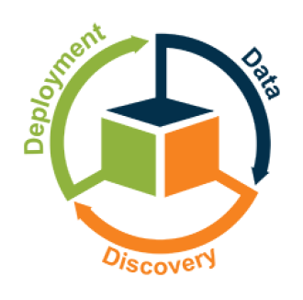
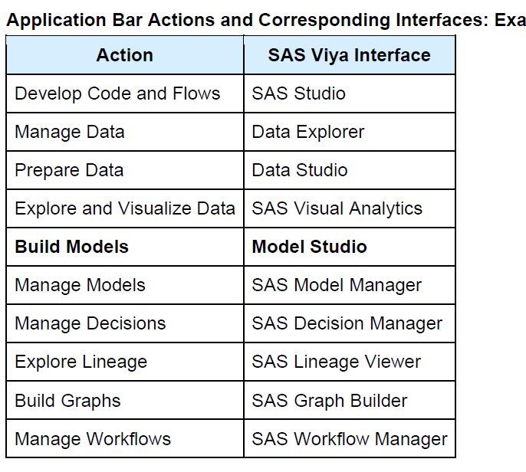
SAS Viya Applications Menu
Notes:
This slide shows the SAS Viya Applications Menu.
It explains which SAS tool you should use for different tasks in the analytics life cycle:
1. Data Tasks
- These are tasks where you work with data:
What you want to do = Tool you should use
Write code or build flows = SAS Studio
Manage and organize data = Data Explorer
Prepare/clean your data = Data Studio
Explore and visualize data = SAS Visual Analytics
2. Build Models
- These are tasks for machine learning or analytics models:
What you want to do = Tool you should use
Manage models = SAS Model Manager
Manage decisions = SAS Decision Manager
Explore data lineage (where data comes from) = SAS Lineage Viewer
Build graphs = SAS Graph Builder
Manage workflows = SAS Workflow Manager
In Simple Words
- SAS Viya provides different applications for different jobs:
SAS Studio → write code
Data Explorer → look at data
Data Studio → clean data
Visual Analytics → create charts and dashboards
Model Manager → organize your machine learning models
Decision Manager → manage business rules and decisions
Lineage Viewer → track data sources
Graph Builder → create custom graphs
Workflow Manager → manage business workflows
- Each tool supports a different part of the Data → Discovery → Deployment life cycle.

Slide 25


SAS Viya Tools for Machine Learning
Solutions
SAS Machine Learning
Data Mining
SAS Viya
Notes:
SAS Viya is a platform that provides many software tools for data mining and machine learning.
These tools help you explore data, prepare it, build models, and use those models to make predictions.
In this course, you will learn how to use the machine learning tools inside SAS Viya.
These tools work together and use the power of SAS Viya’s cloud system so you can build predictive models and put them into real use.

Slide 26
SAS Machine Learning
SAS Visual Text Analytics
SAS Visual Forecasting
Model Studio
interface
hub
SAS Drive
SAS Viya
Notes:
SAS Drive is the main webpage where you start when using SAS Viya.
It is the single place where you can access all SAS Viya tools.
From SAS Drive, you can open Model Studio, which lets you use the features of SAS Machine Learning through an easy-to-use, web-based interface.
Model Studio also works as the interface for two other SAS Viya tools:
SAS Visual Text Analytics
SAS Visual Forecasting
Which tools you can access depends on your license agreement—meaning what your organization has paid for.
So, SAS Drive = hub, and Model Studio = interface for different machine learning and analytic solutions.

Slide 27
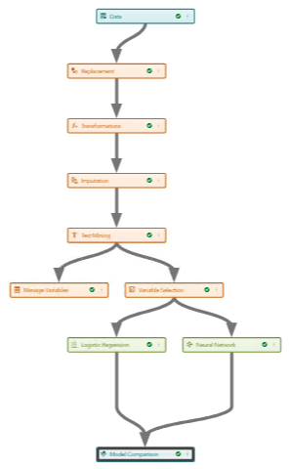
SAS Machine Learning
Data Source
Project
Pipeline
Model Studio
Metadata
SAS Drive
SAS Viya
Notes:
In Model Studio, all your analytic work is organized inside something called a project.
A project is like a folder that keeps everything for your machine-learning work in one place.
A basic project includes three main parts:
Data Source – the data you will use for your analysis.
Pipeline – the workflow you build.
A pipeline is a step-by-step process that shows how the data is prepared, modeled, and analyzed.
Metadata – extra information that describes the project.
The pipeline is shown as a diagram, where each node (box or circle) represents one analytic step (such as preparing data, training a model, scoring, etc.).
You build your full analysis by connecting these nodes together.

Slide 28
SAS Machine Learning
Data Source
Project
Pipeline
Model Studio
Metadata
project type
project creator
creation date
last update
SAS Drive
SAS Viya
Some examples of project metadata are the project type, project creator, creation date, and last update.
Notes:
In a Model Studio project, there is information stored about the project itself.
This information is called metadata.
Some examples of project metadata are:
Project type – what kind of project it is
Project creator – who created the project
Creation date – when the project was created
Last update – the most recent time the project was changed
This metadata helps you understand and manage your project inside SAS Viya.

Slide 29
SAS Machine Learning
Data Source
Project
Pipeline
Model Studio
multiple pipelines
Pipeline
Pipeline
Pipeline Comparison
SAS Drive
Metadata
SAS Viya
A project can also have multiple pipelines and pipeline comparison results.
Notes:
In SAS Model Studio, one project can contain more than one pipeline.
A pipeline is just a step-by-step workflow that builds a machine learning model.
Because a project can have many pipelines, you might want to compare them to see which pipeline gives the best results.
SAS Model Studio can create a pipeline comparison so you can easily see which model performs best.
Even Simpler Version
A project can include several pipelines.
Each pipeline builds a different model.
You can compare these pipelines to choose the best model.

Slide 30
HTML Placeholder
SAS Drive and the Application Bar
Notes:
TAG_MovieNum:
ecpml4101_1_g

Slide 31
Demo: Creating a Project and Loading Data
In this demonstration, you create a new project in Model Studio based on the commsdata data set.
Notes:
TAG_MovieNum: ecpml4101_1_hdemo

Slide 32

Question: Model Studio
Model Studio is a web-based platform that includes a suite of integrated data mining tools to facilitate end-to-end data mining analysis. Model Studio can be used with SAS Machine Learning in SAS Viya and two other visual tools: SAS Visual Text Analytics and SAS Visual Forecasting.
True
False
Notes:
TAG_MovieNum: ecpml4101_1_q1
CA: True
FB: Model Studio can be used with SAS Machine Learning in SAS Viya and two other visual tools: SAS Visual Text Analytics and SAS Visual Forecasting.

Slide 33
Answer: Model Studio
Model Studio is a web-based platform that includes a suite of integrated data mining tools to facilitate end-to-end data mining analysis. Model Studio can be used with SAS Machine Learning in SAS Viya and two other visual tools: SAS Visual Text Analytics and SAS Visual Forecasting.
True
False
Notes:
TAG_MovieNum: ecpml4101_1_q1
CA: True
FB: Model Studio can be used with SAS Machine Learning in SAS Viya and two other visual tools: SAS Visual Text Analytics and SAS Visual Forecasting.

